Slide 1
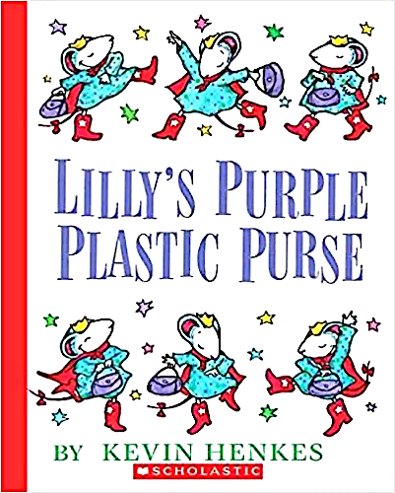
Literature:
The Perfect Connection to Students’ Feelings

Slide 2
Read the book aloud.
In the story, Lilly is angry at her favorite teacher, Mr. Slinger,
for taking away her beloved purple, plastic purse. She even
writes a mean note to the teacher.
Stop occasionally to model.
Ask kids to tell a partner what they are thinking.
Offer sentence starters for Els, shy or inarticulate students.
-This makes me think…
-I feel just like Lilly when…
-I don’t like it when…
-One time I…

Slide 3
The story is a metaphor for feelings students may be
experiencing during this pandemic or at any time in their lives.
Like not being able to…
-do the things you love
-go to school
-be with your friends
-go to your favorite places
-take part in sports
Because of this, students may feel…
-anger
-disappointment
-sadness
-loneliness

Slide 4
Reread the first pages of the book.
Tell students that unlike Lilly, you don’t love a purple, plastic purse, but you do love ________.
Model aloud as you write a “Copy Change” of the first two pages of the book with the topic about what you love.

Slide 5
Ask kids to tell a partner what they love.
Guide them to write and illustrate their own “copy change”.

Slide 6
-Next, tell students how you felt when you couldn’t paint because you ran out of paints and all the art stores were closed.
-Invite students to share with a friend their feelings about not getting to do some of the things they love because of the pandemic.
-Record their feelings. Model first, then invite students to create a poem or prose using some of the feeling words.
Offer examples and poem frames
Mad
Upset
Lonely
Sad
Furious
Down
Unhappy
Invisible
Confused
Bored
Other Ways Students Might Connect & Express Their Feelings
When I can’t _______, I feel ______.
Sometimes it makes me _________.
It’s just not fair that I can’t _______.
So I’m just feeling ___________.

Slide 8
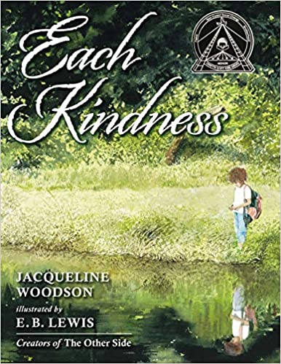
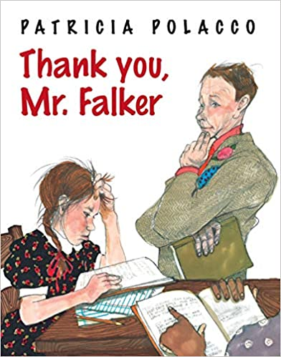
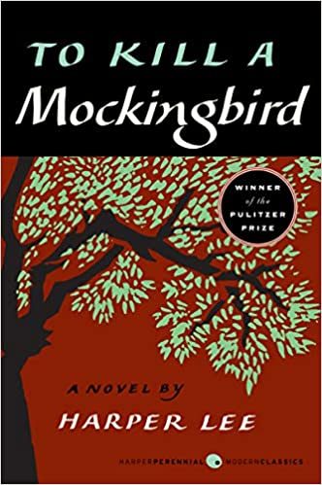
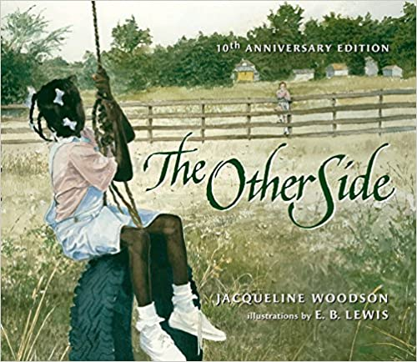
Almost Every Book Has a Social Emotional Connection
Happy Reading!

