Slide 1
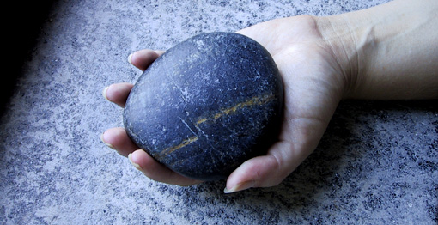
Rock Writing Fun

Slide 2
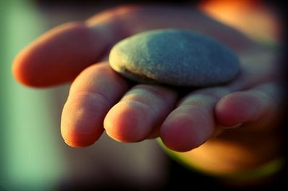
Find a Rock. Tell Someone…
How it looks
How it feels on
your hand and
cheek
How it sounds
How it smells

Slide 3
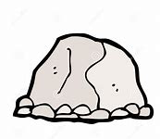
Sketch and Label Your Rock
cold
Rounded on top
like a little mountain
striped
black, gray and white
broken
Feels snug in my hand
gritty

Slide 4
Learn More About Rocks

Slide 5
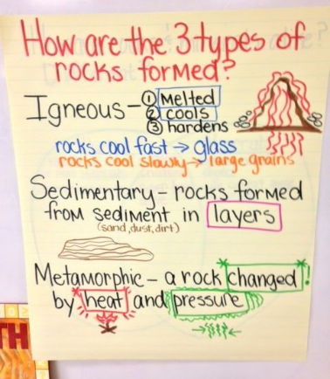
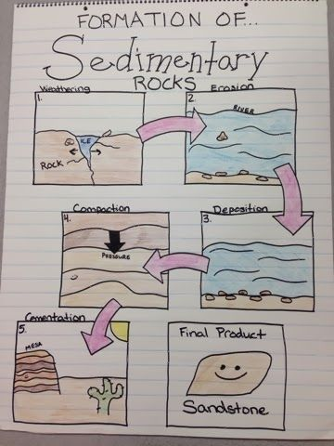
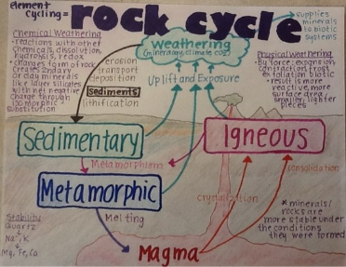
Make a Chart About What You Learn

Slide 6
Write Sentences Poems, Paragraphs,
Write To Learn

Slide 7
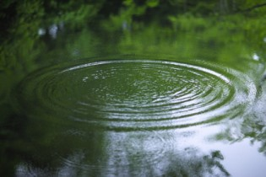
Try a
Rainbow Sentence
A flat, dusty rock splashes
noisily into the pond.
adjective
noun
verb
adverb
prepositional phrase
Don’t forget cool blue capitals and purple punctuation!

Slide 8
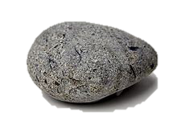
5 Senses Poem
Example
This rock feels ____.
It’s colors are________.
It sounds like ________.
It’s smell is _______.
I named it _______.

Slide 9
Cool, quiet rock,
Spangled with speckles and stripes,
You feel heavy and smooth in my hand,
Please tell me your secret.
5 Senses Poem
Example

Slide 10
Describe Your Rock-Draw or Paint a Picture of It
My rock is oval and has a broken side.
It looks like an egg. When I rub it on my cheek it feels cool. It’s colors are gray, white and black. I see a little hole in it.
Example of Informative, Descriptive Writing

Slide 11
Informative, Descriptive Paragraph Example
A rock feels cool and comfortable in your hands, rough here, smooth there. What are its colors and markings? Look closely. Like a geologist, you will discover the secrets of your rock’s creation. Is it striped with colored layers formed on the sandy bottom of a sparkling pond? Or does your rock shine like dark glass, spewed out of a fiery volcano? Lucky you, if it sparkles like crystal. Your rock survived boiling and cooling beneath the earth.

Slide 12
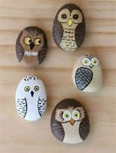
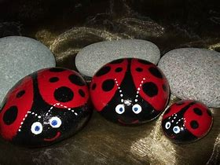
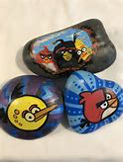
Paint Your Rock

Slide 13
Finish This Story or Make Up a Story About Your Rock
Beginning: A tiny gray rock was lying under a tree.
Middle: A big bird flew down and pick it up in her beak. She thought it was a big seed to feed to her babies.
Problem:
Solution:

Slide 14
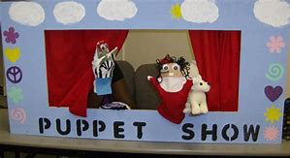
Write and Perform a Rock Puppet Play
Write a script and perform it using your painted rock characters.
Invite family to watch or make a video of your play to share with far away family and friends.

Slide 15
Family Check-In
At some point in the day, get together and check in with each other to see how everyone is feeling.
Each person pretends that their rock is doing the talking.
Ex: “I’m feeling good because I read a book today.”
“I’m missing seeing my friends.”

Slide 16
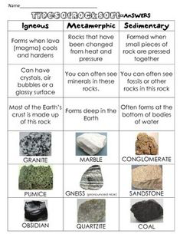
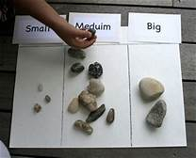
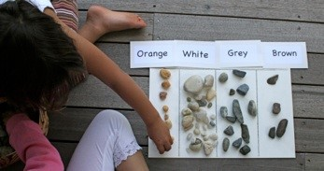
Don’t Forget Math
Sort rocks by attributes. Make a visual of your findings.
How many in each category? Most? Least?
Arrange rocks into patterns
Language support: This rock is ____ -than_____.

Slide 17
HAVE FUN!!!

